Slide 1

Natural Language Processing
Rohit Kate
BERT – Part 2

Slide 2
Reading
Chapter 9 (skip code) & Section 10.2 from Textbook 1

Slide 3
Contextual Embeddings
BERT gives contextual embeddings for the tokens
Same polysemous word (e.g. “left”) will get different embeddings in different contexts (driven by the attention mechanism within the input)
T_{[CLS]} T_{I} T_{arrived} T_{late} T. T_{[SEP]} T’_{All} T’_{had} T’_{left} T’. T’_{[SEP]}
Encoders
[CLS] I arrived late . [SEP] All had left . [SEP]

Slide 4
Contextual Embeddings
BERT gives contextual embeddings for the tokens
Same polysemous word (e.g. “left”) will get different embeddings in different contexts (driven by the attention mechanism within the input)
Different embedding
T_{[CLS]} T_{I} T_{turned} T_{right} T. T_{[SEP]} T’_{All} T’_{turned} T’_{left} T’. T’_{[SEP]}
Encoders
[CLS] I turned right . [SEP] All turned left . [SEP]

Slide 5
Fine-Tuning BERT
Pre-trained BERT captures general aspects of language using large corpora
It can then be adapted to a specific NLP task with some annotated data
Two Options:
Option 1: Freeze encoder weights and only learn the outer weights
Option 2: Learn all weights; encoder weights initialized with the pre-training weights

Slide 6
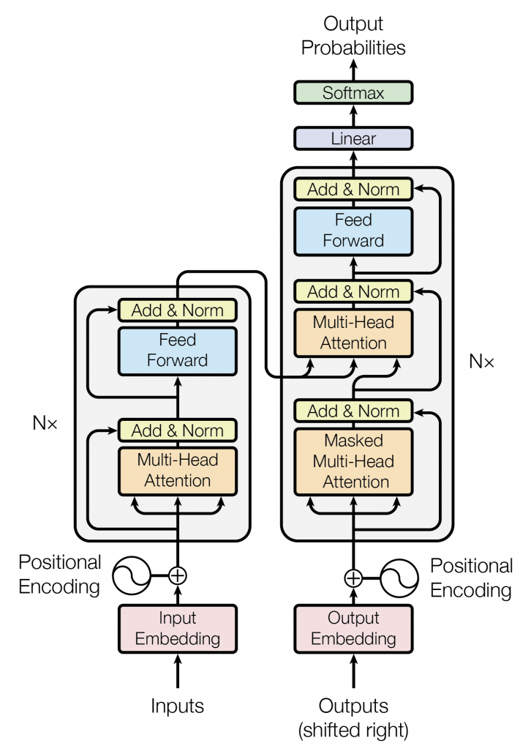
Fine-Tuning BERT
Task Output
Option 1
Fine-tuning
More layer(s)
Learn Weights
New Representation
Pre-trained
Freeze Weights

Slide 7
Fine-Tuning BERT
Task Output
Option 2
Fine-tuning
More layer(s)
Learn Weights
New Representation
Pre-trained
Relearn Weights

Slide 8
Fine-Tuning BERT
Option 1
Computationally cheaper
Suitable for smaller fine-tuning training data
May not find the best overall network for the task
Option 2
Computationally expensive
Will need big enough fine-tuning training data
More likely to find a better overall network for the task

Slide 9
Fine-Tuning BERT
BERT can be adapted to different types of inputs as needed for a task
Following are the main categories of tasks:
Single sentence classification
Sentence pair classification
Single sentence tagging
Text selection
A “sentence” could mean some text in the above

Slide 10
NLP Tasks
General Language Understanding Evaluation (GLUE) benchmark
Collection of resources for training and evaluating on diverse natural language understanding tasks
Serves as benchmark datasets (11) for evaluation of NLP methods
Freely available
https://gluebenchmark.com/
Good examples of various types of tasks
https://gluebenchmark.com/tasks

Slide 11
Single Sentence Classification
Classify a given sentence into pre-defined categories
Example Tasks:
Sentiment analysis: Given a text (e.g. review or tweet), classify if it is positive/negative/neutral or happy/sad/angry/neutral etc.
Example dataset from GLUE: The Stanford Sentiment Treebank (SST-2)
Two Classes: Positive (1)/Negative (0)
“comes from the brave , uninhibited performances” → Positive
“we never feel anything for these characters” → Negative

Slide 12
Single Sentence Classification
Linguistic Acceptability: Given a sentence, is it grammatical or not
Example dataset from GLUE: The Corpus of Linguistic Acceptability (CoLA)
Two classes: Acceptable (1)/Unacceptable (0)
“They made him to exhaustion.” → Unacceptable
“The wagon rumbled down the road.” → Acceptable
Spam filtering: Given an email, is it spam or not
Document Classification: Given a document classify it under categories news/science/sports etc.

Slide 13
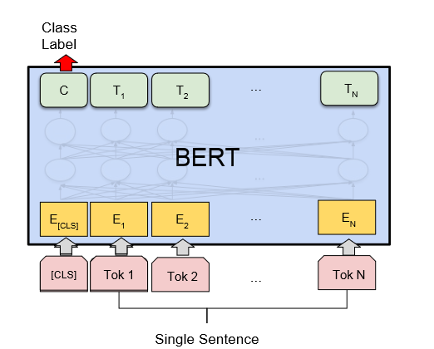
Single Sentence Classification
Input: The sentence/text
BERT’s output: Use the CLS token’s representation
Could have a few NN layers followed by softmax for classification
Output: Class label

Slide 14
Single Sentence Classification
pos: 0.9 neg: 0.1
Softmax
T_{[CLS]}
BERT

Slide 15
Single Sentence Classification
pos: 0.9 neg: 0.1
Softmax
Dense x 64
T_{[CLS]}
BERT

Slide 16
Sentence Pair Classification
Classify a given pair of sentences into pre-defined categories
Example Tasks:
Textual Entailment: Can the second text be concluded from the first text
Example dataset from GLUE: Recognizing Textual Entailment
Two classes: entailment, not_entailment
Text 1: “Yet, we now are discovering that antibiotics are losing their effectiveness against illness. Disease-causing bacteria are mutating faster than we can come up with new antibiotics to fight the new variations.”
Text 2: “Bacteria is winning the war against antibiotics.”
Label: entailment
Text 1: “As regards the headquarters building, the Swiss are stipulating that they would transfer it to the WTO for a value of about 51 million swiss franks.”
Text 2: “The WTO headquarters are in Switzerland.”
Label: not_entailment

Slide 17
Sentence Pair Classification
Other textual entailment example datasets from GLUE:
Multi-genre Natural Language Inference (MNLI)
Diagnostics Main
Question-Answering: Given a question and a paragraph, is the answer in the paragraph
Example dataset from GLUE: Question Natural Language Inference (QNLI)
Two classes: entailment, not_entailment
Question: “What came into force after the new constitution was herald?
Paragraph: “As of that day, the new constitution heralding the Second Republic came into force.”
Label: entailment
Question: “The Tower District is centered around which historic theatr
Paragraph: “The theater was built in 1939 and is at Olive and Wishon Avenues in the heart of the Tower District.”
Label: not_entailment

Slide 18
Sentence Pair Classification
Other example datasets from GLUE
QQP: Quora Question Pairs
If two questions are semantically equivalent
STS-B: The Semantic Textual Similarity Benchmark
How semantically similar are the two sentences
MRPC: Microsoft Research Paraphrase Corpus
Is one sentence semantically equivalent of the other

Slide 19
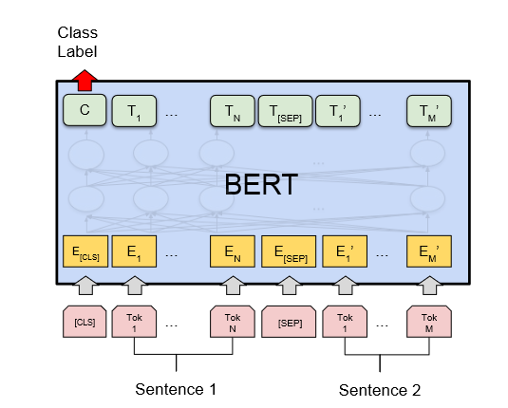
Sentence Pair Classification
Input: Two sentences separated by [SEP]
BERT’s output: Use the CLS token’s representation
Could have a few NN layers followed by softmax for classification
Output: Class

Slide 20
Single Sentence Tagging
Given a sentence, tag all its tokens
Example tasks:
Named-entity recognition: Recognize pre-defined entities such as person, organization, location, etc. from a given text
Use Begin/Inside/Other (BIO) labels
Austin/B-PER lives/O in/O Los/B-LOC Angeles/I-LOC
Example dataset: CoNLL 2003 NER task https://paperswithcode.com/dataset/conll-2003

Slide 21
Single Sentence Tagging
Semantic role labeling: Can also be cast as sequence labeling task
Tag patient, agent, instrument etc. in the sentence with BIO labels
John/B-Agent gave/O Mary/B-patient a/O book/B-instrument

Slide 22
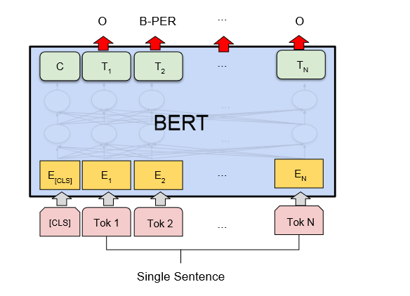
Single Sentence Tagging
Input: The sentence
BERT’s output: Representations of all the tokens
Could have a few NN layers followed by softmax for classification
Output: Tag for each token

Slide 23
Text Selection
Given a sentence and a text, select the relevant part from the text
Example Task:
Question-Answering: Given a question and a paragraph, select the answer from the paragraph
Example dataset: SQuAD: Stanford Question Answering Dataset
https://rajpurkar.github.io/SQuAD-explorer/
Paragraph: “ . . . Other legislation followed, including the Migratory Bird Conservation Act of 1929, a 1937 treaty prohibiting the hunting of right and gray whales, and the Bald Eagle Protection Act of 1940. These later laws had a low cost to society—the species were relatively rare—and little opposition was raised.”
Question: Which laws had less opposition?

Slide 24
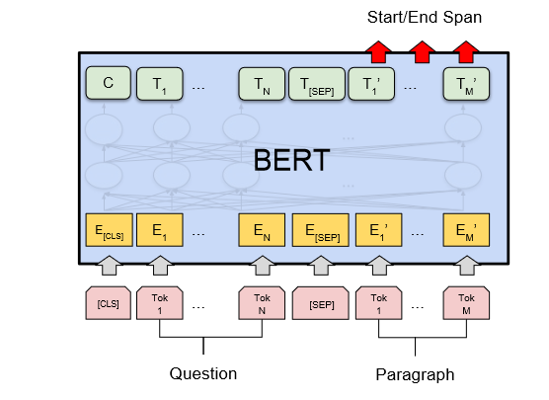
Text Selection
Input: The sentence and paragraph separated by [SEP]
BERT’s output: Representations of all the tokens
Introduces Start (S) and End (E) vectors
S.Ti represents likelihood of i being the start token (softmaxed over all tokens); analogously done for E.Ti
Output: The span from i to j for which S.Ti + E.Tj is maximum is the output

Slide 25
BERT Models
Can be downloaded from Hugging Face (Transformers Library)
Hugging Face (Transformers Library)
https://huggingface.co/bert-base-uncased
Case and uncased versions
Also from:
https://github.com/google-research/bert

Slide 26
BERT Models
BERT models come in various sizes varying the number of:
Number of transformer layers (L)
Size of hidden layer (H)
Number of self-attention heads (A)
Common ones:
BERT_{BASE} (L=12, H=768, A=12, Total Parameters=110M)
BERT_{LARGE} (L=24, H=1024, A=16, Total Parameters=340M).
BERT has a hard limit on the number of input tokens: 512
Not a theoretical limitation

Slide 27
BERT Variations
RoBERTa (Robustly optimized BERT)
Second-most referenced after BERT
Pretrained on 160 Gb of text as opposed to 16 Gb by BERT
Does not use next-sentence prediction (NSP) task for pre-training
Generally performs better than BERT
Easy to switch from one to the other
https://huggingface.co/roberta-base

Slide 28
BERT Variations
DistilBERT
Uses knowledge distillation technique to learn a smaller and faster model
Trained to mimic BERT (teacher model) using a smaller model (student model)
40% smaller and 60% faster
97% of task performance
Only a small drop
https://huggingface.co/distilbert-base-uncased-finetuned-sst-2-english

Slide 29
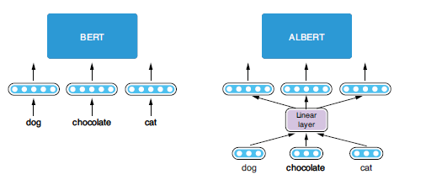
BERT Variations
ALBERT (A Lite BERT)
Smaller dimensionality of word embeddings (128)
These are then expanded using a linear layer to match the input dimensionality of the model (768)
Figure 9.13 from Textbook1.

Slide 30
BERT Variations
ALBERT (A Lite BERT)
Parameters are shared between the transformer layers
Sentence-order prediction (SOP) is used instead of next-sentence prediction (NSP) during pre-training
Predict the order of two consecutive segments of text
Which comes before the other?
Could scale-up training and out-perform BERT-large with fewer parameters
https://huggingface.co/albert-base-v2

Slide 31
Domain-Specific BERTs
BERT architecture can be adapted to different domains
Pre-train it with a lot of text from that domain
ClinicalBERT:
Pre-trained for clinical domain
Clinical notes (discharge summaries, radiology notes, etc.)
1.2 Billion words
https://huggingface.co/medicalai/ClinicalBERT
BioBERT:
Pretrained on biomedical text
https://github.com/dmis-lab/biobert

